Slide 1


Building an Effective Transitional Work Program
The webinar will begin soon

Slide 2
Building an Effective Transitional Work Program
ICW Risk Management Services

Slide 3


Today’s Presenter:
Teresa Kwon, ARM
Sr. Risk Management Consultant

Slide 4

Today’s Topics
Transitional Work Programs
The Benefits
Transitional Job Tasks
Steps to Blueprint
Partnering with ICW Group
Resources

Slide 5

Transitional Work Programs

Slide 6
TWP vs. RTW?
Transitional Work Program:
PROACTIVE - In place BEFORE injuries occur.
Tasks, requirements and processes established prior to an injury.
Ready to invoke when needed.
Return to Work Program:
REACTIVE - Activated AFTER an injury occurs.

Slide 7
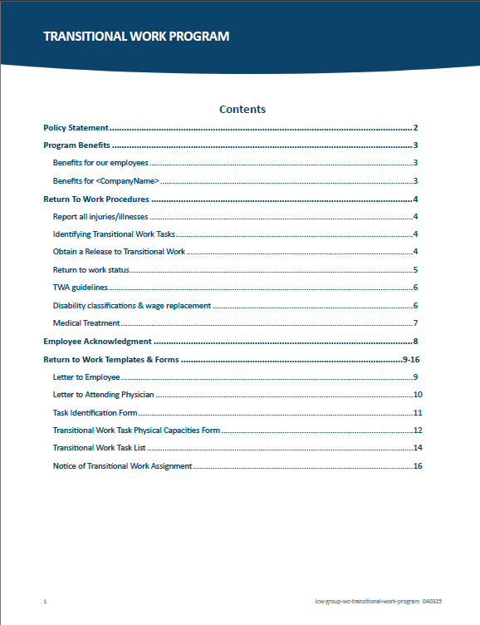
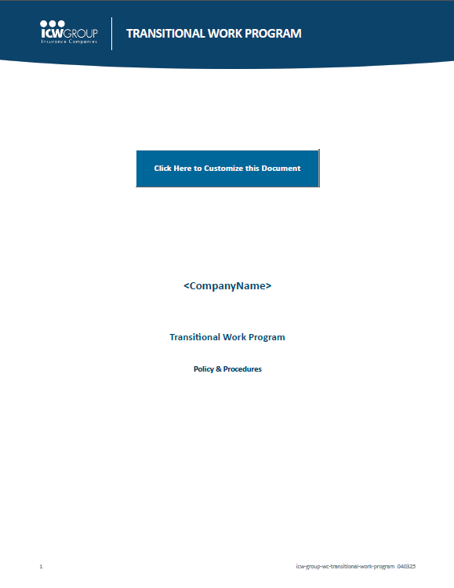
What is a Transitional Work Program?
Designed to have action in place.
Tailored to fit needs.
Transitions injured worker
back to full duty.
We’re including a TWP plan
as part of this webinar!

Slide 8
The Benefits

Slide 9
The Benefits - Financial
Reduces direct costs:
Medical & indemnity costs.
Associated claims costs (mileage, prescriptions, etc.).
Reduces indirect costs:
Range from 1 to 20 times more than direct costs.

Slide 10
The Benefits - Financial
Reduces Time Lost
After 12 weeks off job
following injury:
~ 50% of workers don’t return!
After 1 year, likelihood
decreases to < 2%

Slide 11
The Benefits - Financial
2023
2021
2020
2019
Impacts Ex-Mod
Fewer & less costly claims reduces
Ex-mod impact.
Based on 3 years of loss experience.
Current policy year and previous
policy year isn’t included in calculation.
2022

Slide 12
The Benefits - Financial
Reduces Litigation
Focus on worker ability vs. worker disability.
Faster claims close, less likely litigation

Slide 13
The Benefits - Financial
Reduces Disability Expense
Studies show reduced length and cost of disability.
Accommodations cost little or nothing - low priority, important tasks that need to be done.
Develop an ability vs disability approach.

Slide 14
The Benefits - Financial
Maximum Medical Improvement Faster
Workers return to regular duty faster.
Can attain maximum medical recovery…
3x faster!

Slide 15
The Benefits - Employee
Employee feels needed and wanted
Part of essential team – “we’re in this together!”
Promotes faster recovery time.
Reduces concerns about losing job.
Provides income stability – still earning a paycheck.
Employee feels valued and useful!

Slide 16
The Benefits - Employee
Faster Recovery Time
Ability vs. disability environment – each day in recovery employee can do a little more.
Continued activity and motion.
Incentive to return to normal work – we need you back in your job with your team.

Slide 17
The Benefits - Employee
Focuses on “Can Do” vs. “Can’t Do”
Can Do: Ability environment
Can be productive!
Can interact with friends and co-workers.
Can monitor adherence to restrictions.
Can’t do: Disability environment
Can’t do same job
  Feels worthless.
  Promotes negative environment.
Concerned of what others think.
Fear of losing job.

Slide 18
The Benefits - Organization
Demonstrates Compassion
Being injured is hard on employees! TWP provides a supportive environment…
Shows commitment to workers.
Improves corporate culture.
Pays off in reduced litigation.
Litigation drives expense in CA workers compensation!

Slide 19
The Benefits - Organization
Deters Fraud & Litigation
WC benefits likely just medical:
Reduced settlements.
Reduced disability.
Injured employees at work instead of home watching
Attorney TV Commercials!

Slide 20
The Benefits - Organization
Lowers insurance costs
Reduces re-injury potential
Maintains productivity
Decreases fraud potential
Reduces litigation costs
Long-term - lowers Ex-mod!
Promotes healing process
Increases sense of job security
Boosts employee morale
Improves labor relations
Management involved
Good business sense
And more!

Slide 21

Optional Job Tasks

Slide 22
Transitional Job Task Examples for TWP
Identify Transitional Job Tasks
Do this BEFORE employee is injured.
Question – What tasks need to be done but aren’t being done because they’re low priority?
Question – If you had a free, extra employee, what tasks would you have them do?

Slide 23
Transitional Job Task Examples
Parts inventory
Facility inspection
Maintenance
Filing
Assist dispatch
Update safety manuals
Work for employer’s charity

Slide 24
Transitional Job Tasks
Example 1
Commercial laundry operation uses hundreds of rolling bins to move laundry. Over time, the wheels get clogged with debris making it harder to move the bins. Cleaning the debris from the wheels needs to be done but it is a low priority.
Maintenance can flip bins over so injured worker can remove debris and lube wheels while seated.

Slide 25
Transitional Job Tasks
Example 2
Commercial laundry operation launders uniforms for hospitality industry. Uniforms get broken buttons and loose threads, detracting from customer satisfaction.
Injured worker can sit at table, trim loose threads, replace worn
or missing buttons.
Customer satisfaction increases.

Slide 26
Transitional Job Tasks
Example 3
Convalescent hospital’s patients with long fingernails and toenails can cause injuries to themselves and staff, and do damage to bedding.
Trimming finger and toenails is necessary but low priority.
Injured worker can sit to trim fingernails and toenails – less scratch
injuries and less damaged bedding.

Slide 27

Your TWP Blueprint

Slide 28
Step 1 – Executive Support & Direction
Provide positive work environment – Ability vs Disability.
Emphasize employees are valued and needed.
Early / ongoing communications to management, employees, clinic & ICW Group.
Identify transitional work tasks prior to injury.
Deliver strong commitment & leadership.

Slide 29
Step 2 – HR Coordinates the TWP
Works with ICW Group Risk Manager to tailor your program.
Communicates / coordinates with clinic.
Works with management to insure TWP tasks lists completed and updated as needed.

Slide 30
Step 3 – Managers Create TWP Task List
Identifies transitional tasks before injury.
Works with Human Resources on task lists
Question – What tasks need to be done but aren’t being done due to low priority?
Question – If you had a free, extra employee, what tasks would you have them do?

Slide 31
Step 4 – Employee Involvement
When TWP is launched, employees informed and provided copies.
TWP is part of new hire process.
From beginning, employees understand they’re needed and valued by company.

Slide 32
Step 5 – Enlist the Clinic in the TWP
HR and senior management meet with clinic director on program to gain support.
Invite director of clinic to visit facility and explain how transitional work tasks will be combined to create meaningful work for injured employees.
Emphasize injured employee’s abilities – not disabilities.

Slide 33

Partnering with
ICW Group

Slide 34
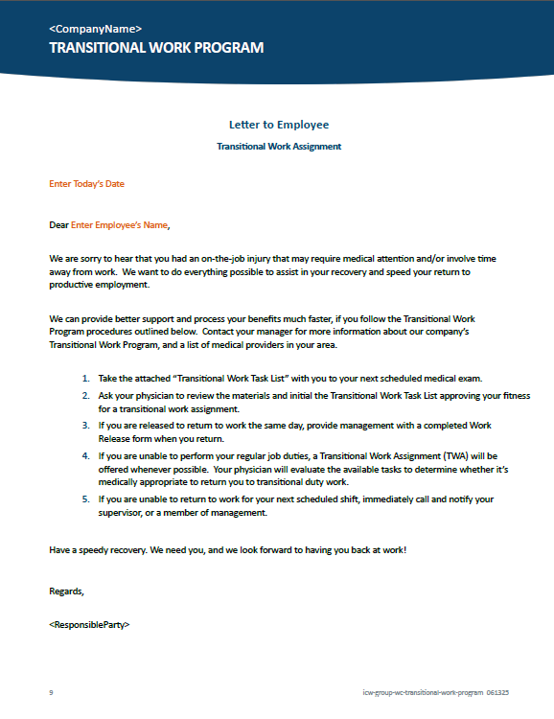
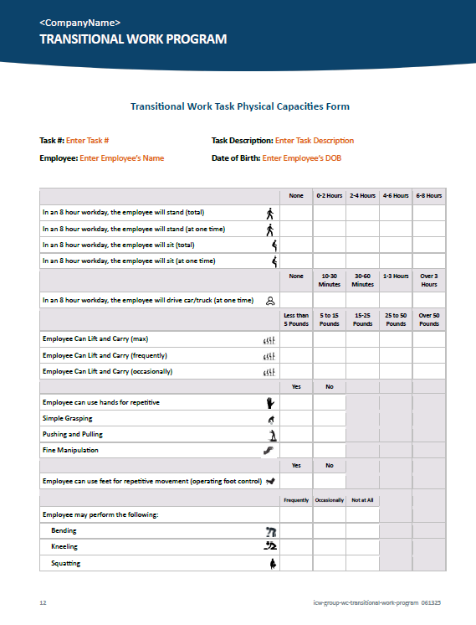
ICW Group’s TWP Program Package
Entire TWP package available
Contains plan and all associated
documents needed on one word file.
Ready to customize, brand and use!

Slide 35
ICW Group’s TWP Program Package
Automated Word Template
Wizard-driven – just add information
about your company and program.
Documented and in place.
Program responsibility and accountability solidly established.
Employees signs for their copy.

Slide 36
ICW Group’s TWP Program Package
TWP Letter to Employee
Provide to employee if injured.
Explains what to take to physician.

Slide 37
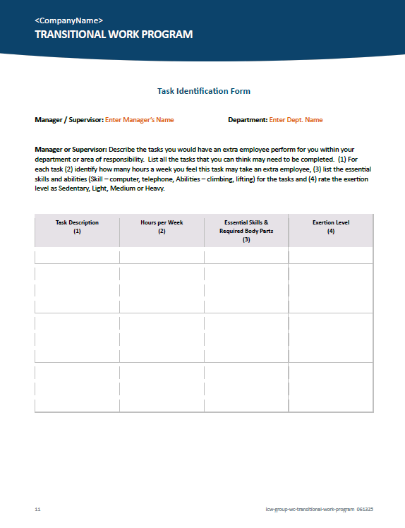
ICW Group’s TWP Program Package
Task List Form
Supervisor identifies work tasks.
  If you had extra worker for day,
  what would you have them do?
  What tasks need to be done,
  but aren’t getting done,
  because low priority?
Fill-out at program rollout, keep updated.

Slide 38
ICW Group’s TWP Program Package
Physician Task List
Tasks identified by manager survey.
Managers initial available tasks in
injured employees work area.
Employee takes to attending physician
for approval (initials).

Slide 39
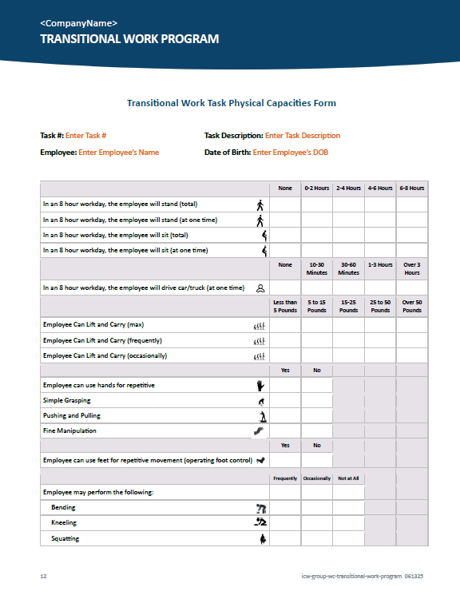
ICW Group’s TWP Program Package
Physical Capacities Form
Complete with Risk Manager and HR
(from job list supervisors identified
during survey).
Lists tasks for transitional work.
Helps clarify tasks for physician’s approval.

Slide 40
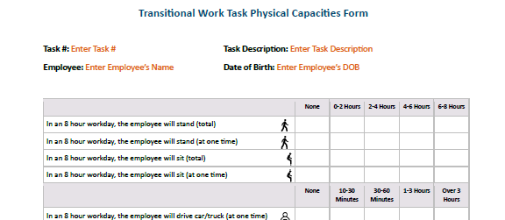
ICW Group’s TWP Program Package
Physical Capacities Form

Slide 41
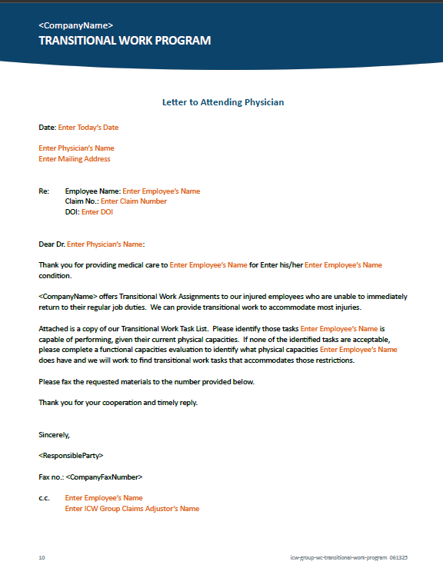
ICW Group’s TWP Program Package
Letter to Attending Physician
Alerts physician transitional work is available.
Include TWP Task List Form and TWP Physical Capacities Form for physician’s signature.

Slide 42
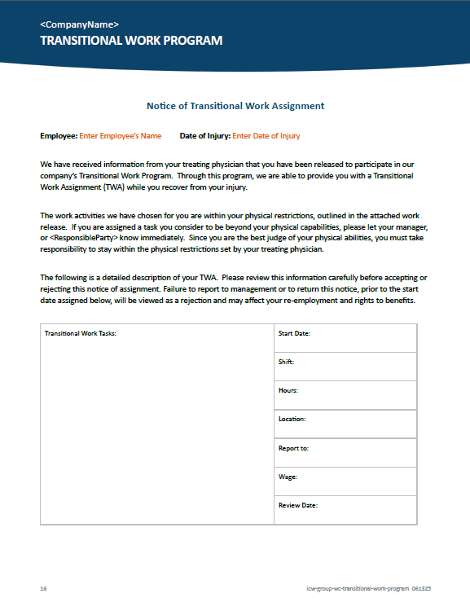
ICW Group’s TWP Program Package
Employee TWP Job Offer Form
Letter explaining temporary work assignment.
Explains the consequences of not participating in program.

Slide 43

Resources
We’re Here for You

Slide 44


ICW Group Website
icwgroup.com/safety
Workplace Safety Resources!
Safety Webinars
Building an Effective Transitional Work Program

Slide 45
ICW Group Website
icwgroup.com/safety
Everything you need for your TWP:
All materials mentioned:
  Customizable TWP Plan.
  All program letters, forms and documents.
Webinar on-demand.

Slide 46

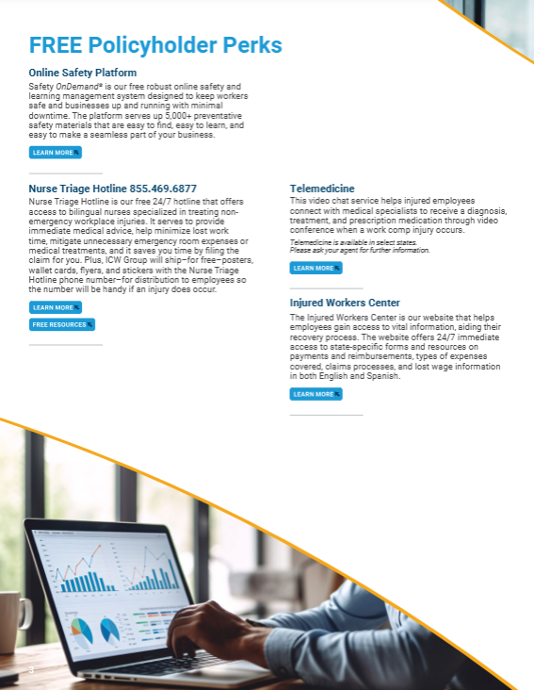
ICW Group Website
icwgroup.com/policyholder-perks
If an employee is injured:
Call the Nurse Triage Hotline for
non-emergency injuries
  Immediate, 24/7 access to a
  nurse to help with next steps
Injured Workers Center to answer questions throughout the claim
Reactive Return to Work programs available through our Claims team

Slide 47
QUESTIONS?
Contact Us: riskmanagement@icwgroup.com

Slide 48
THANK YOU!
Contact Us: riskmanagement@icwgroup.com

